Slide 1

History & Future: Remote Sensing & Telemetry in Malaysia (Agency, Industry & R&D)

Slide 2
DEFINITION
Remote sensing is the process of detecting and monitoring the physical characteristics of an area by measuring its reflected and emitted radiation at a distance
Telemetry is the in situ collection of measurements or other data at remote points and their automatic transmission to receiving equipment (telecommunication) for monitoring.

Slide 3
HISTORY OF REMOTE SENSING IN MALAYSIA
Malaysia was introduced to the Landsat technology about a year prior to the launching of the Landsat-I in july, 1972. It could be of interest to brief here the initial exposure Malaysia had to the programmes
The formation of the National Remote Sensing Committee (NRSC) of Malaysia was formally endorsed in August 1978, though the committee has already been functioning much earlier.

Slide 4
THE REPRESENTATIVE OF REMOTE SENSING FROM THE FOLLOWING AGENCIES
Directorate of National Mapping
Ministry of Defence
Economic planning Unit, Prime Ministers Department
Forestry Department
Agriculture Department
Geological Survey Department
Division of Environment, Ministry of Science, Technology and Environment
Geography Department, University of Malaya
Drainage and Irrigation Department
Agriculture University of Malaysia
Rubber Research Institute of Malaysia
Malaysian Agricultural Research and Development Institute (MARDI)
Land and Survey Department, Sabah
Land and Survey Department, Saravak

Slide 5
REMOTE SENSING IN DIFFERENT SECTORS IN MALAYSIA
National Mapping
Agriculture
Forestry

Slide 6
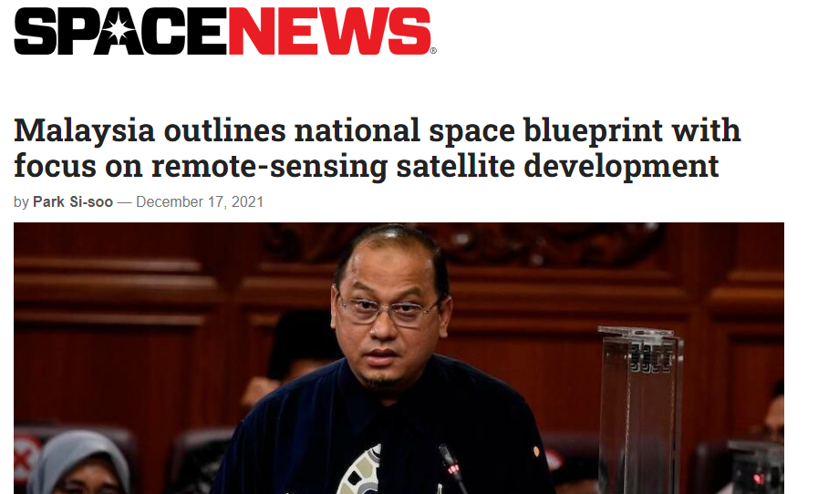
FUTURE OF REMOTE SENSING
Malaysia’s National Space Policy 2030. The policy, adopted in 2017, recognizes the importance of space technologies for the country’s economic growth and national security.

Slide 7
TELEMETRY IN MALAYSIA
Tasik Chini Research Centre (TCRC) has been using sensors to monitor water quality at Lake Chini since 2010. TCRC complements the works of the Department of Environment (DoE) in monitoring the water quality by collecting readings of parameters used to calculate the Water Quality Index
TCRC constructed seven telemetry stations to measure and record water quality parameters at seven different rivers that formed the inflow and outflow streams of the lake.

Slide 8
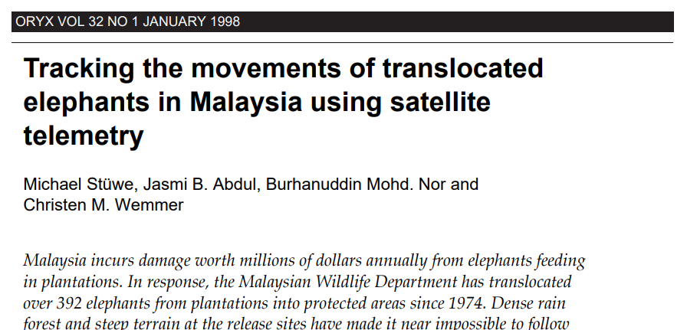
TELEMETRY IN WILDLIFE
Due to the vast forests, Malaysia uses telemetry to assist in locating animals and protesting wildlife in the country.

Slide 9
THANK YOU!

